Slide 1
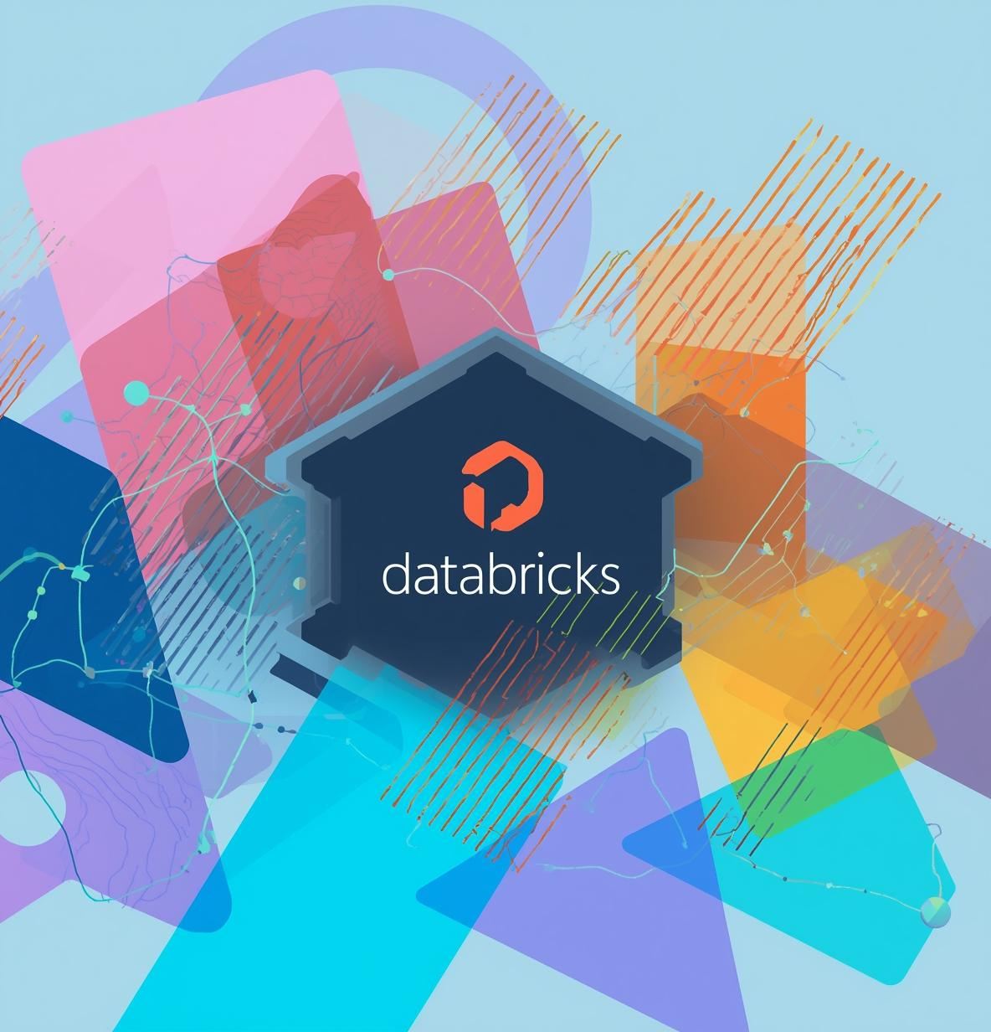

Databricks Asset Bundles (DABs) & Databricks CLI

Slide 2

Defining DABs
Databricks Asset Bundles are a way to deploy Databricks jobs, notebooks, and pipelines using configuration files instead of manually creating them in the UI.
🔹 What Problem Do DABs Solve?
Before DABs:
Manual job creation in UI
Difficult to maintain Dev/Prod consistency
Hard to automate CI/CD
Drift between environments
With DABs:
Everything defined in code (databricks.yml)
Version controlled in Git
Same bundle deployable to Dev, Test, Prod
Supports CI/CD pipelines

Slide 3

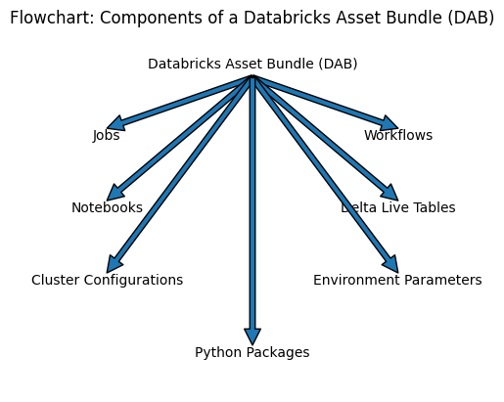

Slide 4
DAB Project Structure
```
dab_project/
├── databricks.yml
├── resources/
│ └── job.yml
├── src/
│ └── notebook.ipynb
└── .databricks/
```
Folder Explanation:
databricks.yml → Main config
resources/ → Job definitions
src/ → Code (notebooks)
.databricks/ → Internal deployment files (auto-generated)

Slide 5

Core File in DAB
📁 databricks.yml
This is the heart of a DAB project.
It defines:
Project name
Resources
Jobs
Cluster configs
Dev / Prod environments
Parameters
It ensures the same configuration works across multiple environments.

Slide 6
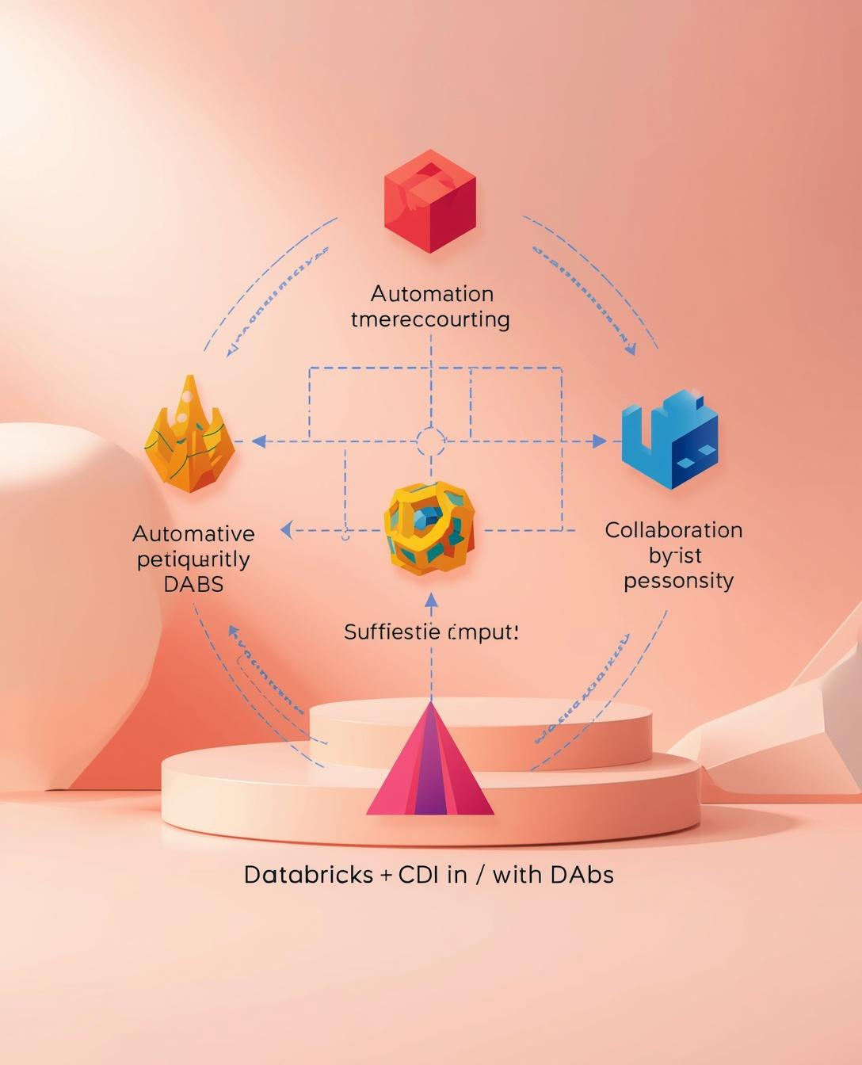
What is Databricks CLI?
The Databricks CLI (Command Line Interface) is a tool that allows you to interact with Databricks workspaces using terminal commands.
Why CLI is Required for DABs
DABs cannot run without CLI.
CLI performs:
Authentication
Validation
Deployment
Job execution
Environment selection

Slide 7
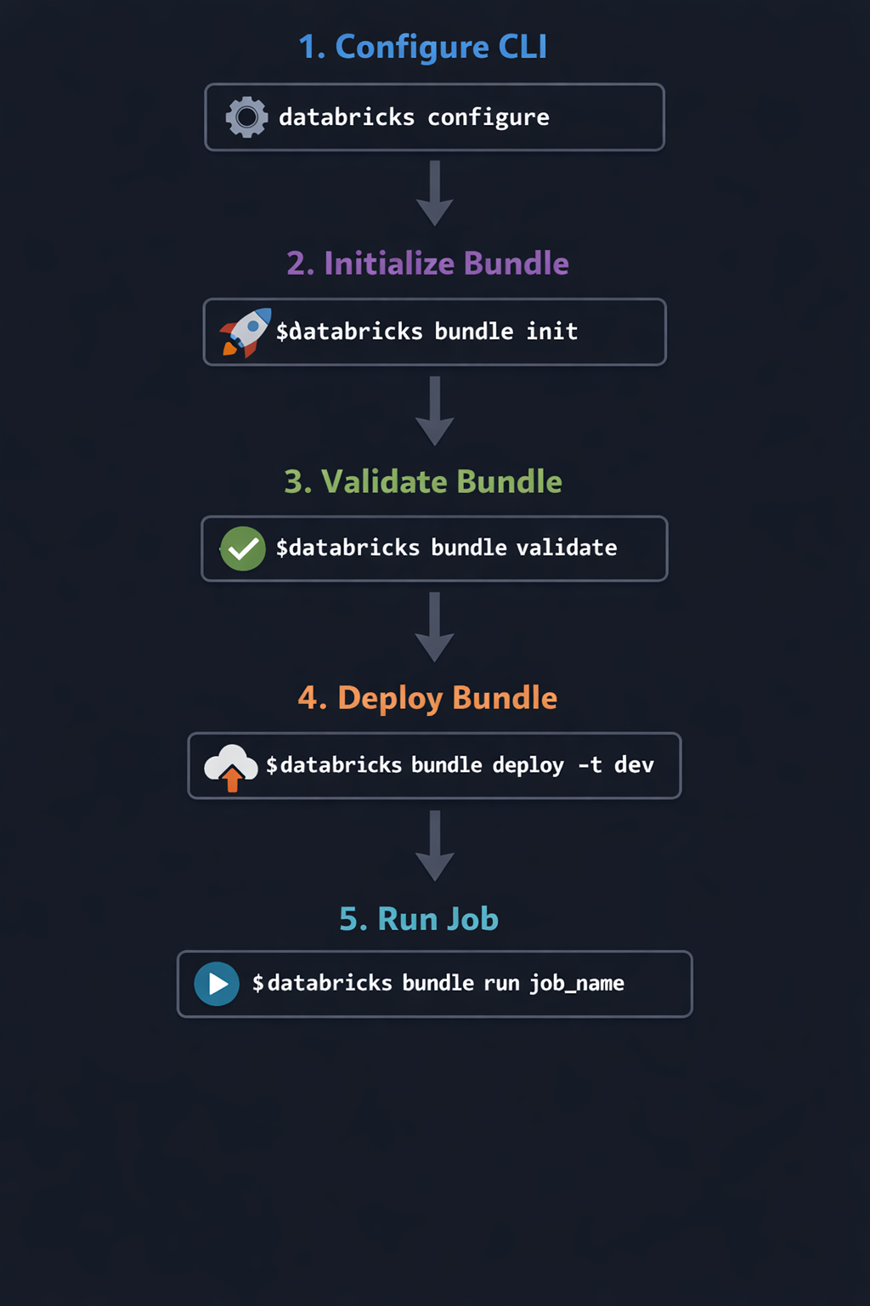
Important CLI Commands for DABs

Slide 8
Typical Workflow
Asset Development
Asset Bundling
Deployment
Create notebooks and jobs locally for testing.
Package assets using DAB format for deployment.
Use CLI commands to upload and run jobs.

Slide 9

Thank You!

